Slide 1
Restaurant Application System
Project name
Prepared by Sukanya wandhekar.
Batch- Edubridge 2021-5880
Enrollment No-EBEONO821430311

Slide 2
Project module
Admin Module
User Module
Menu Module
Order Module

Slide 3
Requirement of Project
Operating system
Windows 7,8,10
Google chrome , Internet Explorer or any browser
Language
HTML
CSS
JavaScript
Java
SQL
Coding tool
Spring Tool Suite 4 (sst)
MySql Workbench

Slide 4
Table Structure
Database Name – Restaurant1
User table
Field | Datatype | Constaint
uid | int | Primary key
uname | Varchar(20)
upassword | Varchar(20)
uemail | Varchar(20)
umobno | Varchar(20)

Slide 5
Table Structure
Admin table
Field | Datatype | Constaint
Adid | int | Primary key
adname | Varchar(20)
adpassword | Varchar(20)

Slide 6
Table Structure
Menu table
Field | Datatype | Constaint
menuid | int | Primary key
menuname | Varchar(20)
menuprice | Varchar(20)

Slide 7
Table Structure
order_table
Field | Datatype | Constaint
Orderid | int | Primary key
menuname | Varchar(20)
Quantity | Varchar(20)
Uname | Varchar(20)
uemail | Varchar(20)

Slide 8
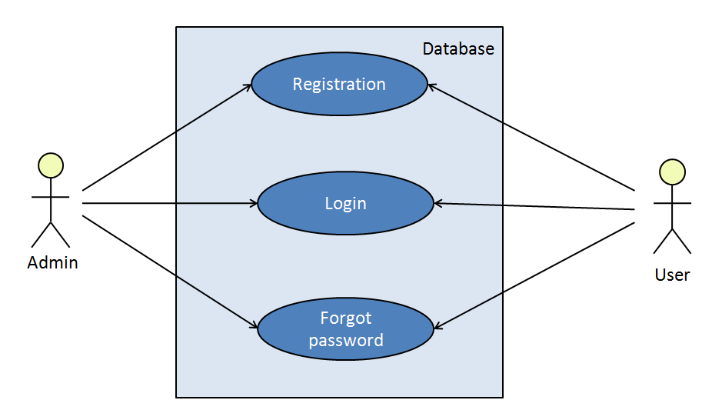
usecase Diagram

Slide 9
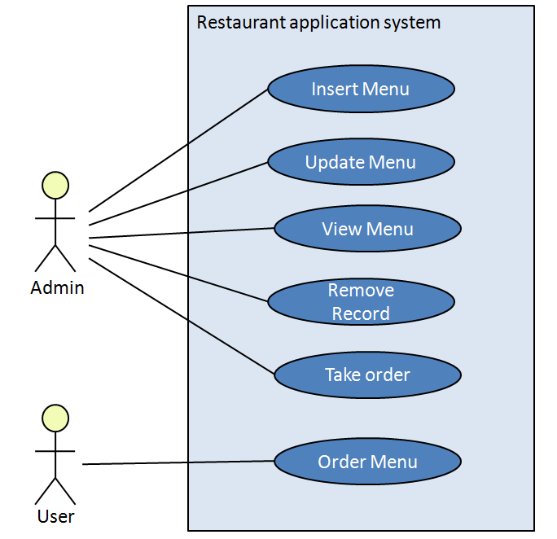
usecase Diagram

Slide 10
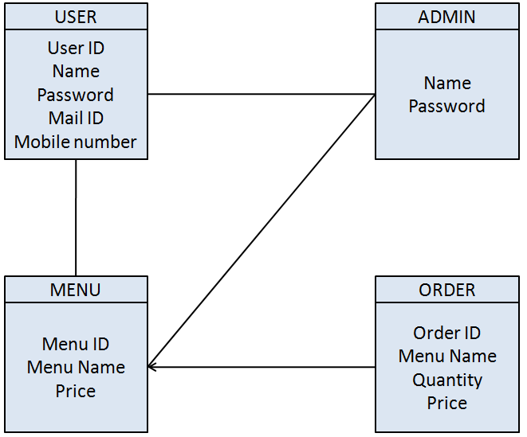
Class Diagram

Slide 11
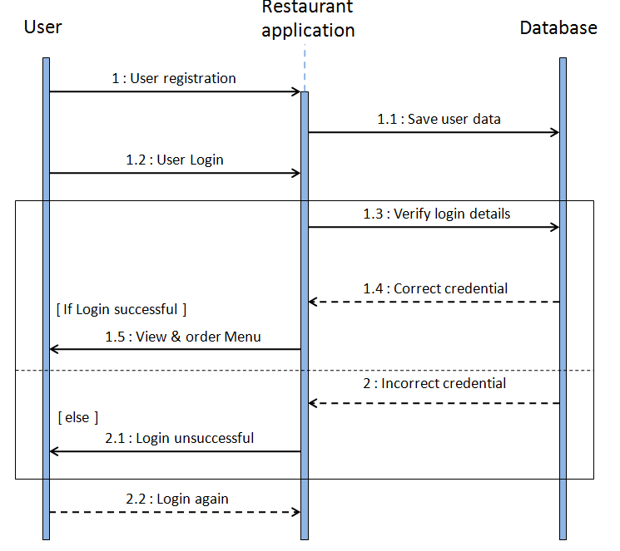
Sequence Diagram

Slide 12
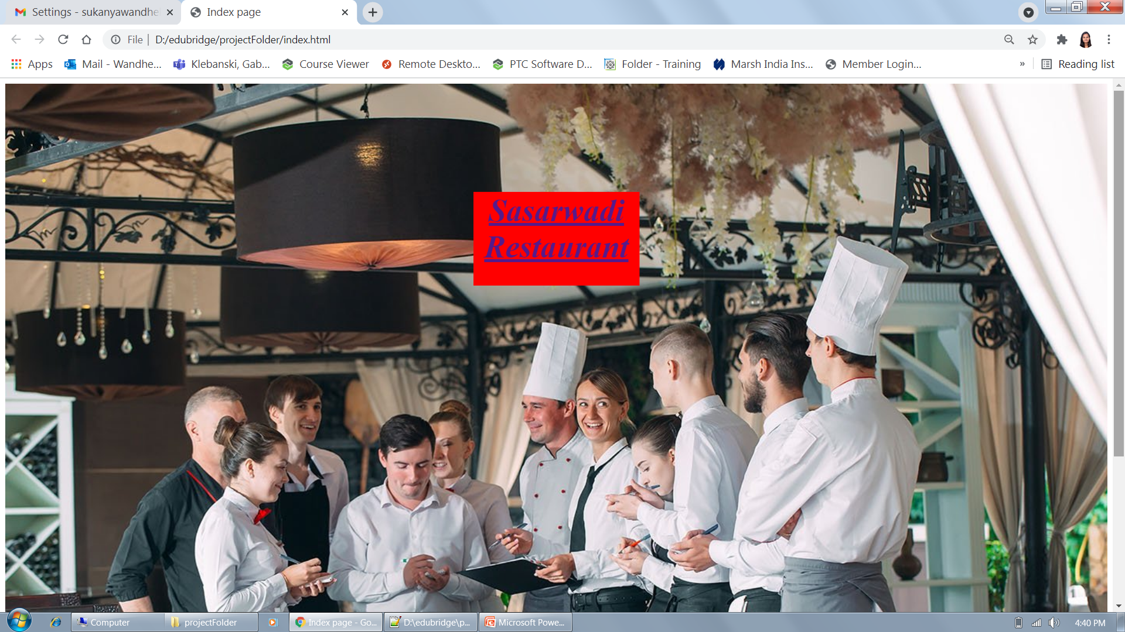
Index Page

Slide 13
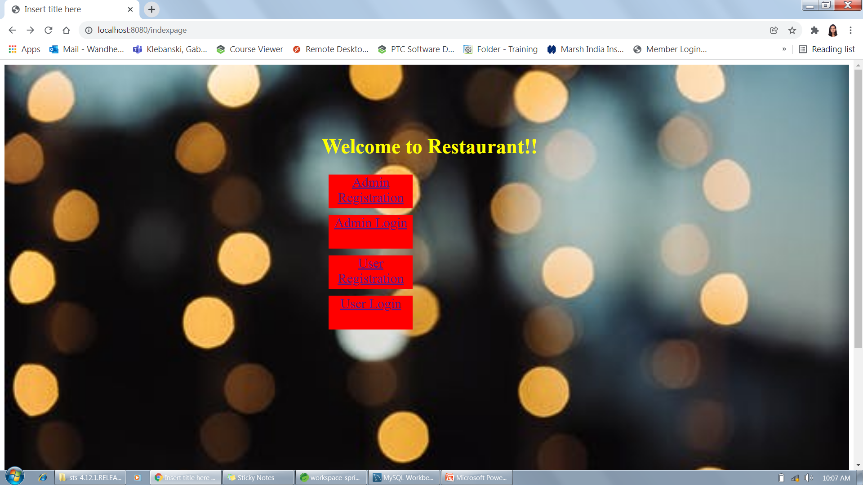
IndexPage

Slide 14
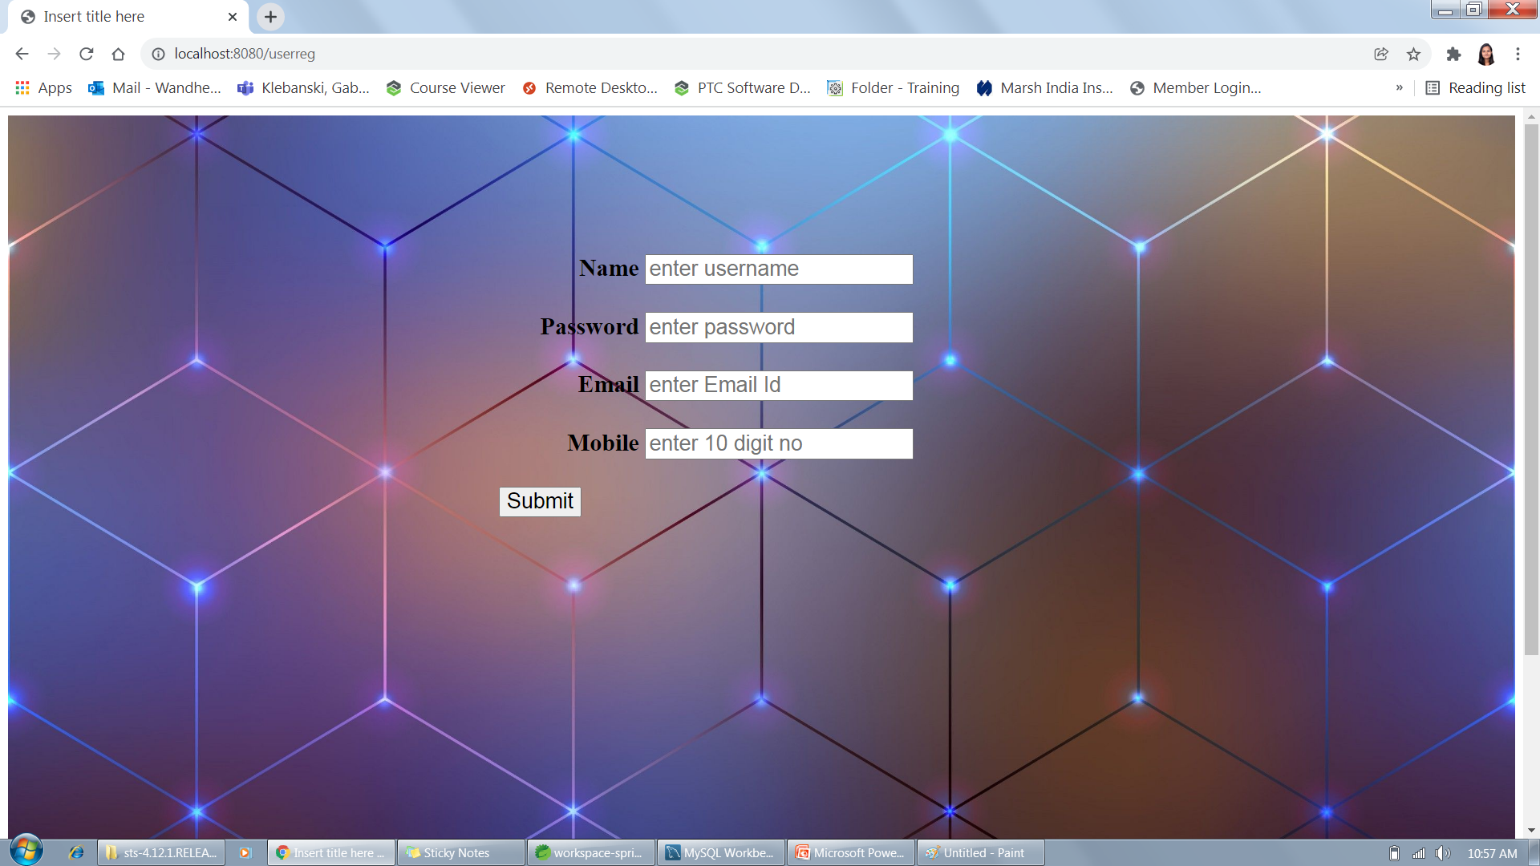
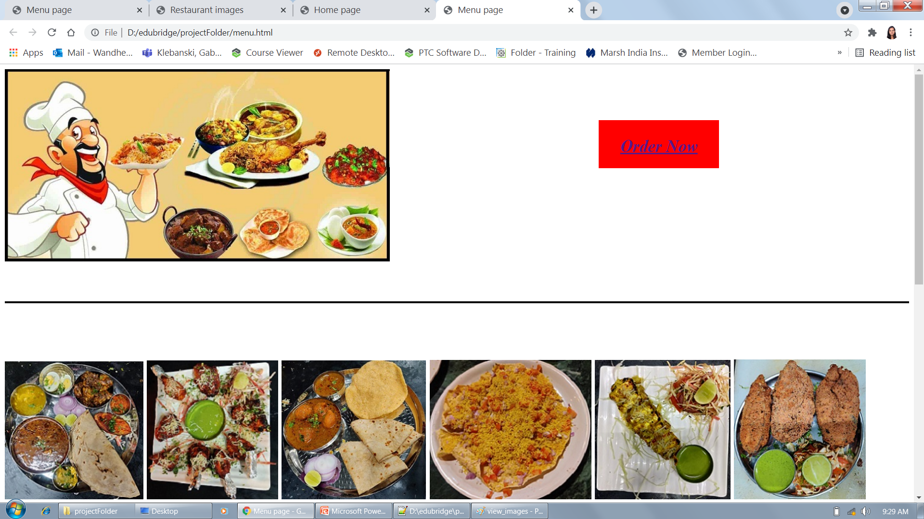
User Registration

Slide 15
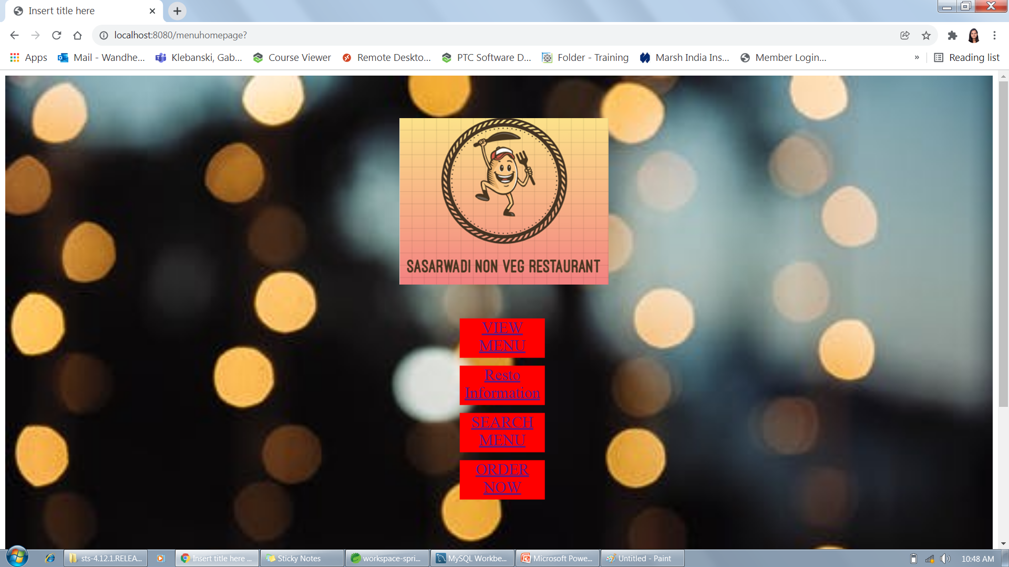
Menu Page
Sign In

Slide 16
View Menu

Slide 17
User Registration

Slide 18
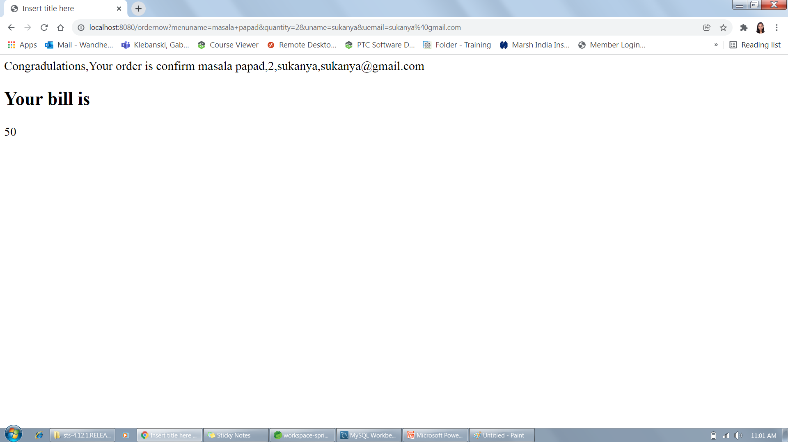
Bill Generation

Slide 19
Thank you

